Slide 1
Data-a-Scientist
Becky Sleath

Slide 2
Exploring the Data
The data contains 3 numerical fields (age, height and income) and a variety of test fields.
A summary of the numerical fields shows that income contains a large amount of -1s. This is not a valid income, but neither is it NaN, so I’ve handled this by replacing -1s here with the column’s mean.
Height has some unlikely-looking low values, but in low numbers. Age also has a couple of outliers, but I’ll leave them in because they are legitimate and maybe useful values.

Slide 3
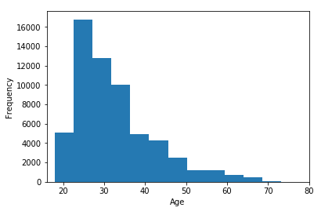
Visualising the data
Age skews right, with most people in their late 20s followed by the early 30s.

Slide 4
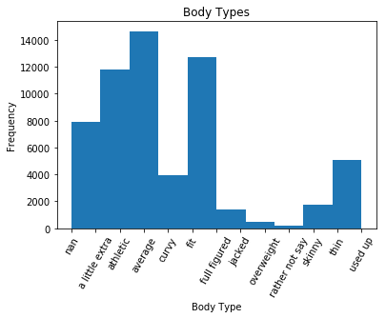
Body Types
People have described themselves as having any of 12 different body types.
How might their body types relate to other features, for example age, height or income?

Slide 5
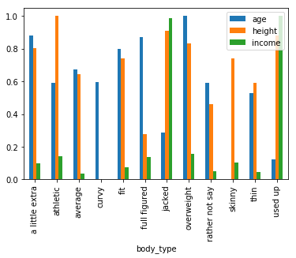
Body Type vs Age, Height and Income
After normalising the variables so that we can look at all 3 together, we can see that types ‘used up’ and ‘jacked’ have much higher incomes than other body types, but it turns out that most people haven’t entered their income so there are few results.
The body types with the average highest ages are ‘overweight’, ‘full figured’ and ‘a little extra’.

Slide 6
Preparing the data
Some of the text fields can easily be made into numerical fields, which will sometimes be easier to work with.
-I’ve mapped each value for sex, smoking, drinking and body type to a number and saved them to new columns.
-I’ve created a new column containing the combined length of each essay in characters.
These values are all much smaller than some other fields like income, so I normalised all numeric fields using min-max.

Slide 7
Classification: Predicting Body Type
I was curious to see if body type could be predicted based on other values: perhaps drinking or smoking, or maybe male and female?

Slide 8
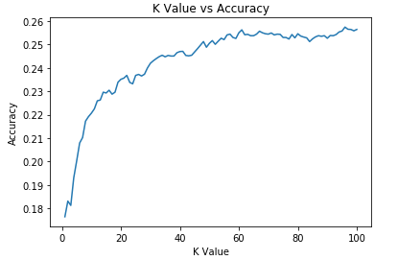
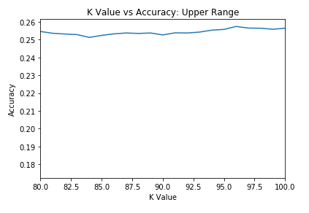
K-Means
The highest accuracy I found was 25.8%, with k=96, although there was very little improvement above 60. Better than a chance pick between 12 types, but not great.

Slide 9
Support Vector Classifiers
I ran 3 versions using 3 types of kernel: linear, polynomial and RBF.
Accuracies were:
Linear: 0.061
Polynomial: 0.063
RBF: 0.061
These are much lower even that the KMeans accuraracy!

Slide 10
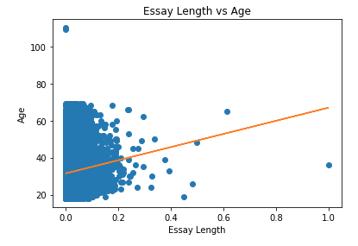
Regression: Predicting Age
I thought perhaps there could be a relationship between essay length and age, so I plotted one against the other, then fitted a line to try to predict age from essay length.
Essay length is does not appear to be a good predictor of age on its own, although there might be a slight positive relationship.

Slide 11
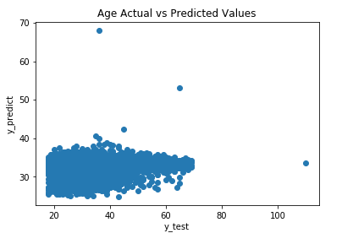
Multiple Linear Regression
Adding more variables could make the linear model more accurate, so I added income, drinking and smoking data.
Plotting the actual versus predicted results for age, there is clearly some sort of relationship. Based on the coefficients, the strongest predictor is still essay length.
However, the model still only explains 2% of the variance in the test data!
Training score: 0.030 Test score: 0.023

Slide 12
Conclusions
Predicting body type
Neither KMeans nor SVC could do this reliably. KMeans was best, but finding the optimal value of k took several minutes to run, while SVC was almost instantaneous but wildly inaccurate. Neither model is much more complicated than the other, either to run or to explain.
Next steps: SVC results could probably be improved by experimenting with different values for C (harder and softer margins) but Kmeans looks like the better approach. I could try KMeans++ and experiement with different treatments of outliers, normalisation and handling incomplete data.

Slide 13
Conclusions continued
Predicting Age
The multilinear model had low scores, but it did show a clear relationship between essay length and age. Adding in more data compared to the first linear model made little difference either to runtime or accuracy but is more complicated.
Next Steps: I’d try a stepwise regression to identify which fields should be included (or at least experiment further with including different fields), then experiment with non-linear approaches.

